Slide 1
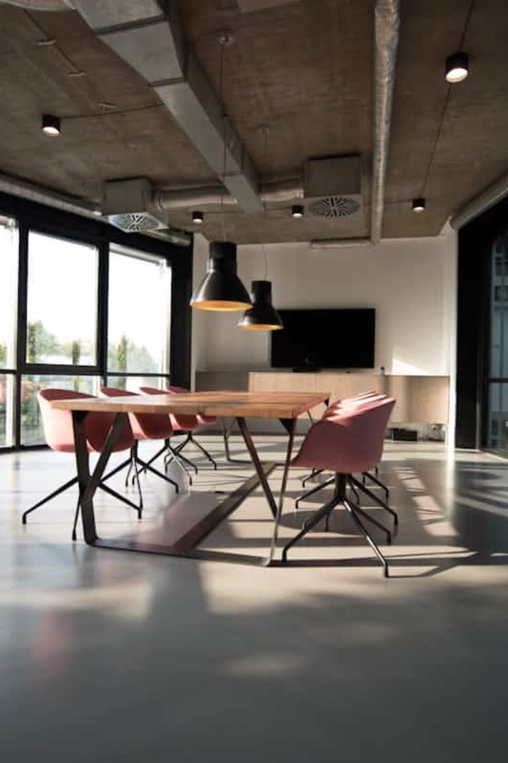

Face Attendance System
Smart, Secure, and Seamless Attendance Solution
Introducing an innovative attendance system designed to enhance accuracy and efficiency.
by أحمد ياسر

Slide 2

Problem Statement
Traditional Systems Flaws
Time-consuming and prone to human error.
Organizational Needs
Require faster, smarter, and more reliable attendance solutions.

Slide 3

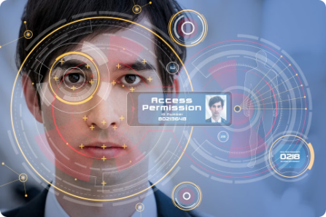



Our Solution
Automated Attendance
User Control
Efficiency
Face recognition technology for quick check-ins.
Secure and customized management features.
Saves time and ensures accuracy.

Slide 5
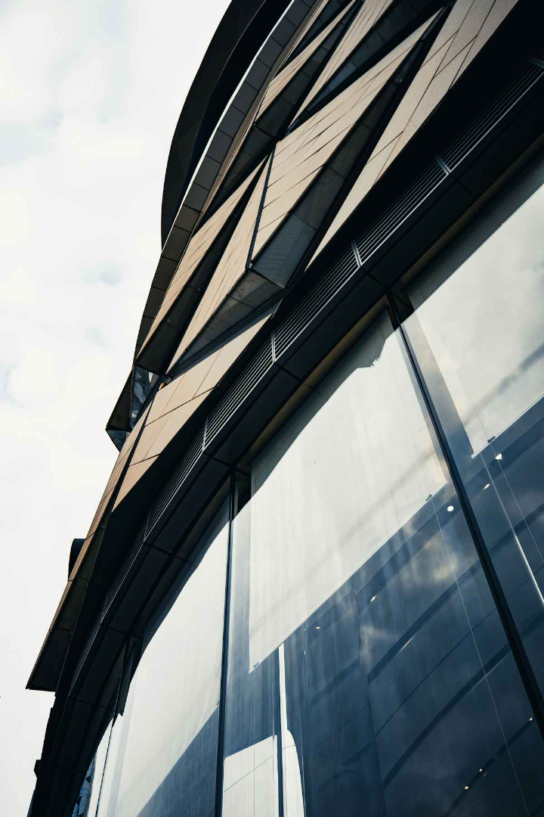




Why Our Face Attendance System Stands Out
Best Solution:
Combines speed, accuracy, and security seamlessly for attendance.
Monetization:
Subscription model and scalable integration for businesses of all sizes.
Competitive Edge:
Advanced AI face recognition surpasses traditional and existing systems.
Why Choose Us:
easy access, lower cost, easy to install, and make the process more better.

Slide 6
Key Features
Performance
User Control
Data Handling
Fast, accurate facial detection
Admin and user management
Automatic CSV export
Optimized for low-end devices
Manual attendance marking option
using sqllite3 for data base
powered by ai
Smooth PyQt5 interface

Slide 7






Technology Stack
Python
OpenCV
SQLite
Dlib
PyQt5
CSV Storage

Slide 8
Competitive Advantage
Our System
Traditional Methods
Face recognition enabled.
Manual entry prone to errors
Fast and automated.
Slow and tedious process
Error-free records.
High error rates common
Exports CSV files easily.
Paper-based records
can be used in another apps or system or political purposes .

Slide 9





Future Vision
Cloud Sync
Real-time attendance data across devices.
Mobile Integration
Access and manage attendance on the go.
AI Behavior Analysis
Enhanced insights into attendance patterns.
Connecting to street surveillance cameras
to identify people for military purposes

Slide 10

Conclusion
Our system revolutionizes attendance with speed and accuracy.
Invest in innovation. Secure your organization's future today.

